Slide 1
Big
Mountain
Resort:
Ticket Price Issue
Presented By: Jae Kim

Slide 2
The Issue
Big Mountain Resort is Losing Out on Revenue!
Our valuable facilities are not being capitalized on
Our Ticket prices are misrepresentative of its true value

Slide 3
The Solution
The Best Scenario:
Add an additional run, increasing the vertical drop by 150 feet and adding an additional chairlift.

Slide 4
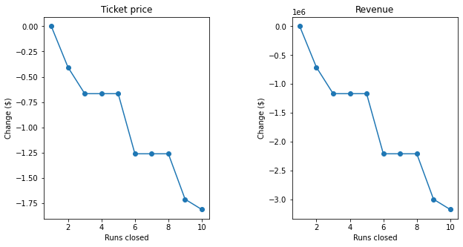
DON’T Close Down 10 of the least used runs
Results of modeling show closing least used runs only reducing Ticket Price and Revenue.

Slide 5
DON’T Increase Longest Run by .2 miles and add 4 acres of snowmaking capability.
Our model suggests increasing longest run or increasing snowmaking has no effect on ticket price.

Slide 6
DO increase vertical drop by adding a run and a chairlift
Model shows adding an additional run and installing an additional chairlift to increase the 150 feet is the best option.
Result:
This scenario increases support for ticket price by $1.99
Over the season, this could be expected to amount to $3474638
The increase in revenue from the change in ticket price will make up for the additional chair lift and more.

Slide 7
“Find the right price for an irresistible offer, which,
by the way, isn’t necessarily the lower price.”
― W. Chan Kim, Author of Blue Ocean Strategy

